Slide 1
Garbage Surveillance Robot
Project by :
Aashirwad N. B. (01FB14EEE004)
Kavin Nishanth (01FB14EEE034)
Koustav Mandal (01FB14EEE038)
Guide: Dr. M. J. Venkatarangan

Slide 2
Problem Statement
To search for garbage sites in a location (for example, the PES campus) and alert the house-keeping authorities.

Slide 3
WHAT TO EXPECT
A mobile robot which can:
1. Learn and repeat a path of the user’s choice
2. Capture images of the path’s surroundings and identify garbage
3. Alert the user of its findings

Slide 4
METHODOLOGY
Study phase
Chalk down the high level requirements for the project map them to corresponding technical specifications
Study papers/references dealing with the similar topics and summarize the contents relevant to the project
List down the test cases to test the working of the robot
Design phase
Based on the technical specifications and other constraints, select the software, electrical and mechanical architecture for the robot
Gain familiarity with the architecture involved

Slide 5
Design the algorithms to be used (for the path repeating and image classifying problems)
Identify the various subsystems involved in the project
3. Implementation phase
Obtain the necessary hardware
Split the work of implementing the different subsystems among members of the team
Implement each of the subsystems involved
Test the algorithms on a pre-built robot
Integrate the subsystems and implement the algorithms on the designed robot

Slide 6
4. System Testing phase
Observe the operation of the robot in the aforementioned test cases
Make corrections/modifications to the system as required
5. Field Testing phase
Test the working of the robot under different simulated and real world conditions

Slide 7
BLOCK DIAGRAM (Tentative)
Power supply
Ultrasonic sensor
Voltage regulator
Raspberry PI 3
Motor Drive
4 Motors
Wheel encoder
Raspberry pi Camera
module

Slide 8
Progress
1. Updated battery and motor requirements
2. Procured material required for the project
3. Tested Inception on a set of images
4. Interfaced motor drivers and encoder sensors to Raspberry pi
(using Python)
5. Tried to interface a camera module to the Raspberry pi (didn’t receive camera sensor data)
6. Calculated encoder requirements and tried to build an encoder disc

Slide 9
Speed Requirements
User requirement:
1. Should
Survey a distance of 200m in about 15 min
Complete at least 4 round-trips before being recharged
Technical requirement:
Distance between the two points = 200m
Assuming it stops every 3m to capture an image of its surroundings and takes 5s to capture and process the image, the time taken to traverse the path = 4 min
Or an average speed of approximately 80 cm/s

Slide 10
Estimating the total robot weight
4 DC motors with gearboxes = 4 * 180 gm = 720 gm
4 wheels + chassis = 370 gm
Total battery weight = 250 gm
Raspberry Pi + Auxiliary weight = 45 + 100 gm
Total = 1.5 kg

Slide 11
Motor and Battery requirements
Top Speed = 75 cm/s
Total Torque = 45 N cm
Motor RPM = 200 RPM
Raspberry Pi Battery WH = 8 Wh
RaspPi Battery = 1600 mAh (at 5.1V)
Motor Battery WH = 5 Wh
Motor Battery MAH = 400 mAh (at 12V)
Total Watt-Hours = 13Wh

Slide 12
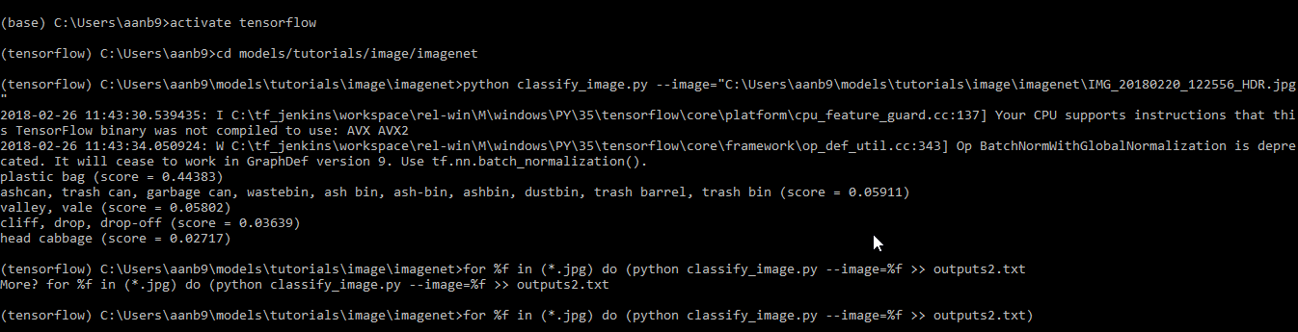
Inception – an image classifier
A convolutional neural network (CNN) which classifies an input image into one of about 5000 categories

Slide 13
Results of testing Inception
Inception was tested on 48 pictures of garbage taken on campus.
Correctly identified: 35
Incorrectly identified: 13
Conclusion: Inception correctly classified objects when the input image clearly had only one major object but it made wrong guesses when the image had a lot of extraneous data (leaves, for example)

Slide 14
Motor Drivers and Encoder Sensor testing
Motor drivers (L293D) were interfaced to the Raspberry pi GPIO pins and were tested on 500 rpm DC motors
Encoder sensors were interfaced to Raspberry pi and an interrupt service routine (ISR) was written to count the number of pulses produced by the encoder sensors

Slide 15
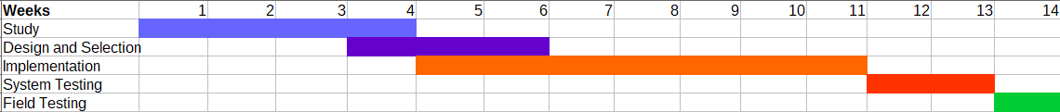
Timeline of project

Slide 16
THANK YOU

